Slide 1
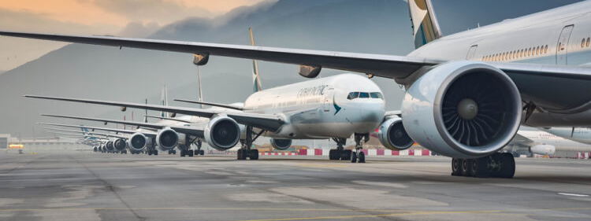
Determining the Cause of Departure Delays in Airports
Pinal Mistry, Evan Duffy and Giancarlo Giudice

Slide 2

Preamble
No one likes to have their flight delayed or cancelled
There are about 30,000 delayed flights per day globally — including 7,000 to 9,000 delayed flights per day in the U.S
Dataset consisting of USA domestic flight data for 2022

Slide 3
Our Mission
1- What are the biggest factors in determining flight delays?
2-Is there a subset of the data (Aircraft age, aircraft type, time in air, departure/arrival airport, etc.) that provides a true correlation to flight delays?
3-Does the number of delays early on in the year cause airlines to receive less business in the latter part of the year?

Slide 4

Initial Step
- Data set Cleaning
- Data taken Into Consideration Including: 'Flight Date, 'Airline’, ‘Origin’, 'Destination’ , 'Departure Time, ’Taxi Out', 'Departure Delay', 'Airtime’, ’Cloud Cover’, 'Active Weather'
Notes:
Introduction: Why we chose our project
For our project, we chose to look at the possible causes for departure delays in airports.
No one likes to have their flight delayed and if we can find out a way to reduce those times, then everyone in the system could benefit.
We found a large dataset from kaggle,
And we had to cut it down so it was usable (it originally had 7 million rows and was rather unwieldly. We parsed it down to just the month of January and 436000 rows).

Slide 5
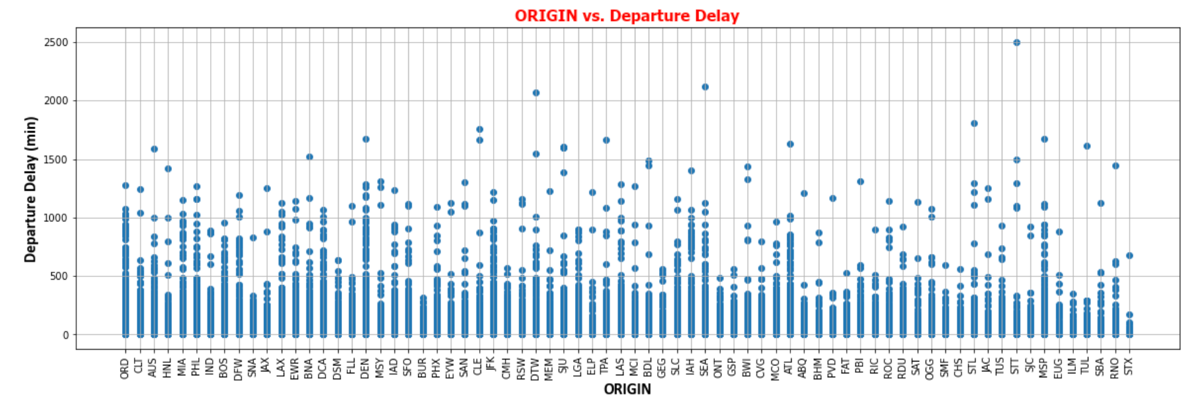
Flight Origin vs Departure Delay

Slide 6
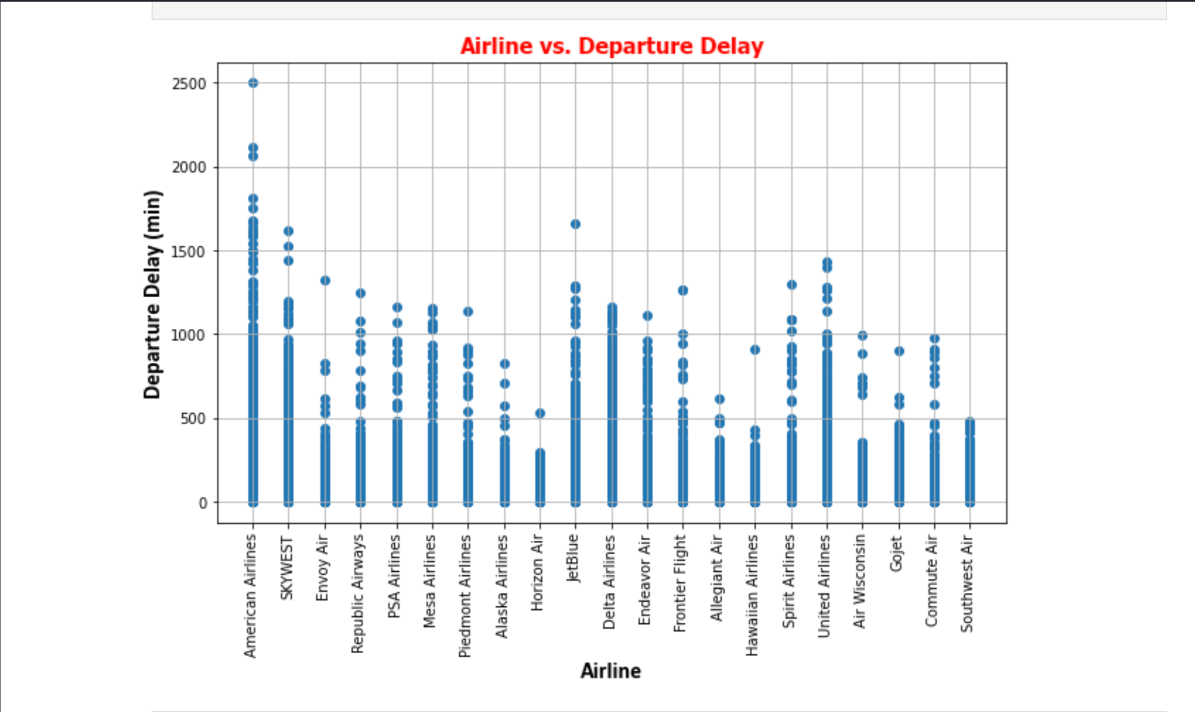
Airline vs Departure Delay

Slide 7
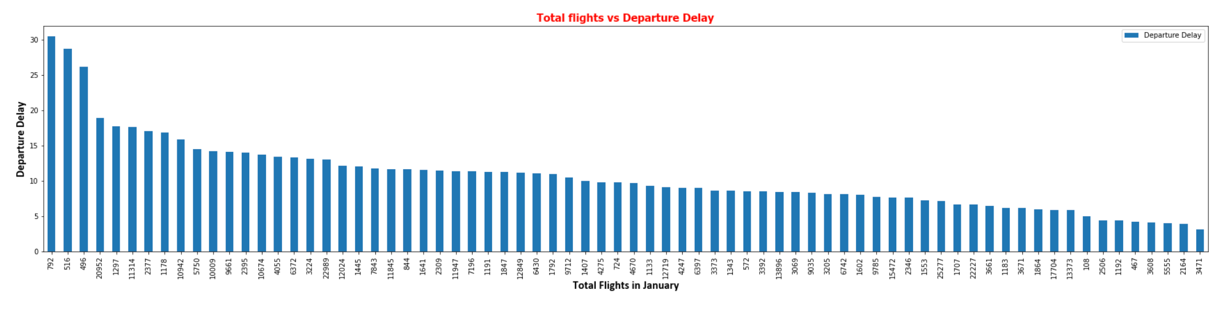
Total Flights vs Departure Delay

Slide 8
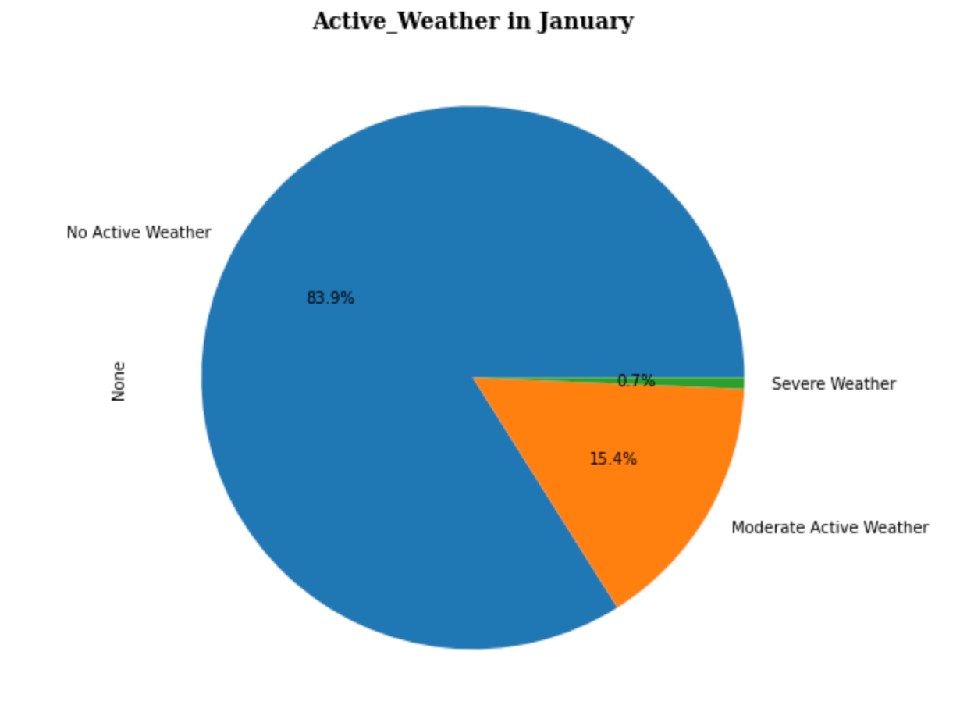
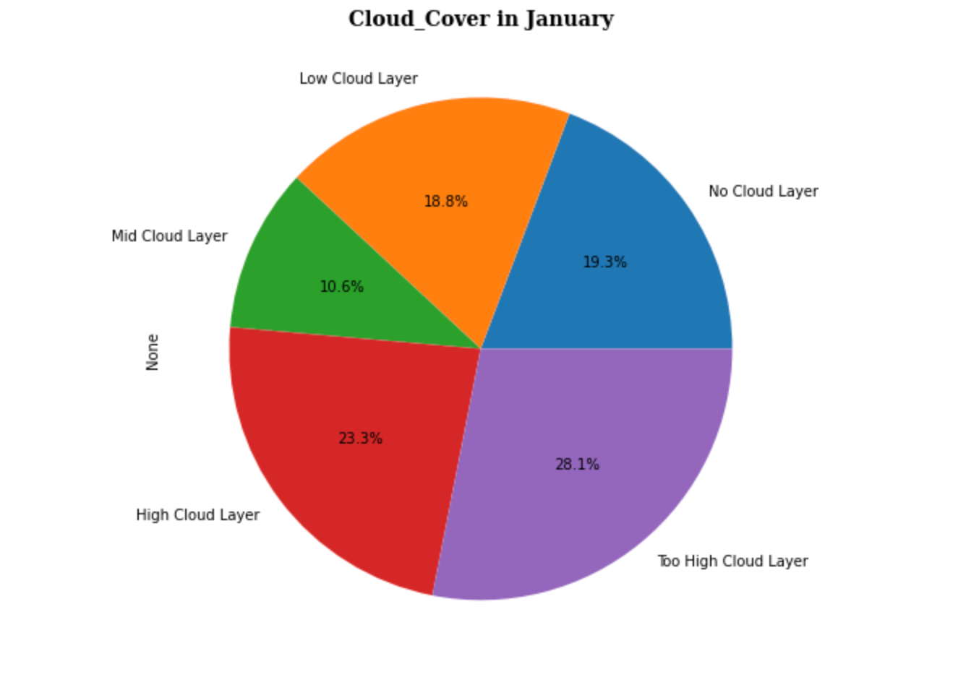
January Active Weather and Cloud Cover

Slide 9
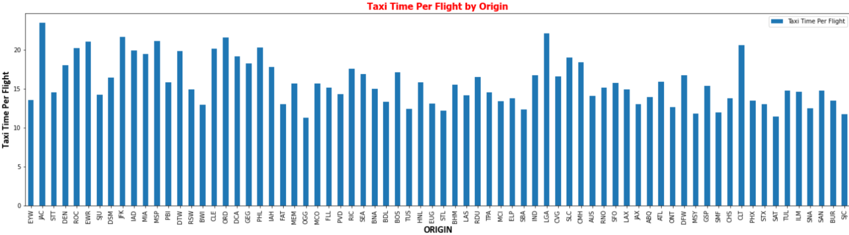
Taxi time Per Flight Origin

Slide 10
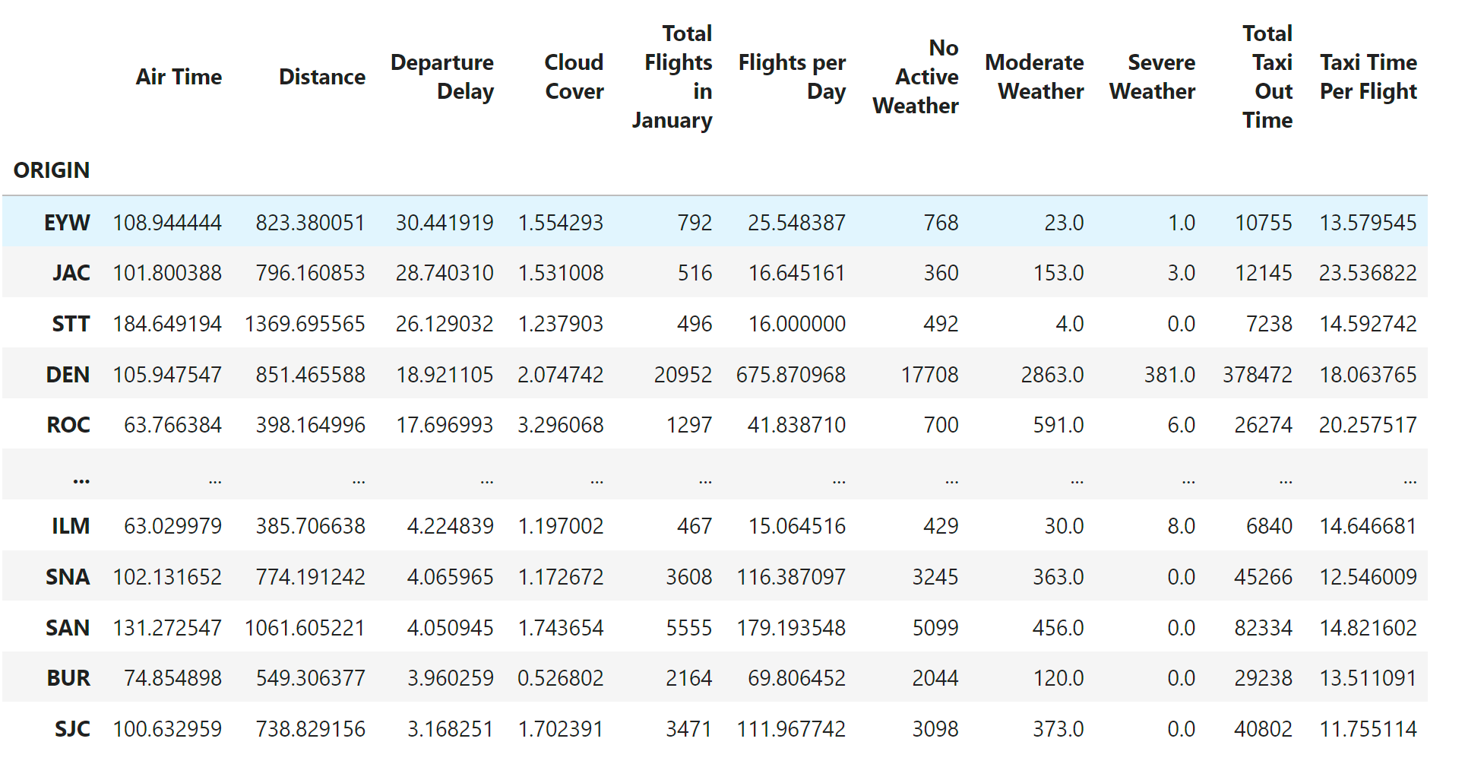
Data Frame shows no Trend

Slide 11

Our Findings
1. From our research, there does not appear to a set condition in determining factors that cause flight delays. We found that the airport with the highest average flight delay was EYW, Key West International airport, and that it was not the biggest airport, nor the busiest, and not even the airport with the worst weather.
2. We determined that -amongst the data used- “Taxi Time per Flight”, was the most impactful factor in determining pre- flight delays via a multilinear regression.

Slide 12
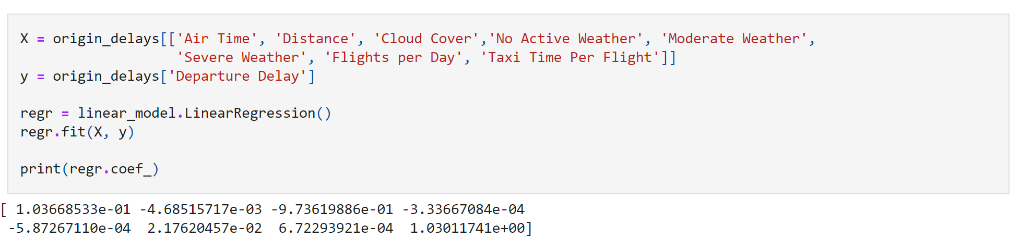
Multi linear Regression

Slide 13
Null Hypothesis
Taxi Flight Times have no affect on Flight Delays

Slide 14
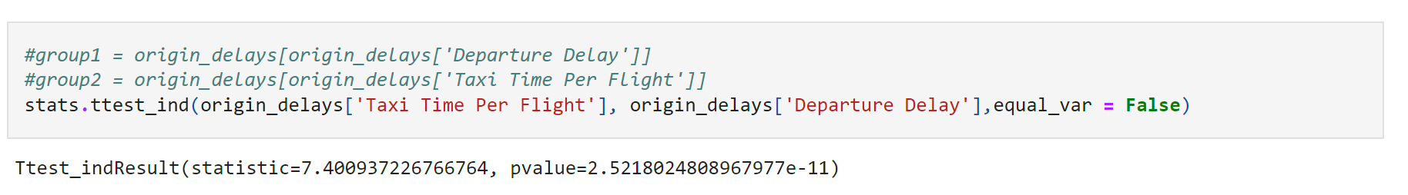
T-Test Results

Slide 15
Conclusion
-In conclusion, we found that there was no discerning pattern in finding a catch all factor when talking about flight delays from data.
-We did however determine that the most impactful factor was Taxi Time per Flight and corroborated its impact being statistically relevant via t test.

Slide 16
Further Considerations
Our last research question was not answerable as the data set was too large initially to be manipulated and we decided that in order to be able to use the data that we would only use one month’s worth of data as that still contained over 500000 rows of flights. If we move forward with this project, parsing through different months would be an interesting direction for us to take.
As we stated earlier, we were not able to parse through the entirety of the data, with our main limiting factor as having only one month of data instead of the whole year, but we would love to look over the rest of the year to see if there are any other details that may arise

